Slide 1

The Japanese School System

Slide 2

Overview
The Japanese Educational Sysytem
The School Hierachy
Teachers
Pupils and Students
English in Japan
The Classroom and Team Teaching
Why We're Here
Notes:
Now that you’re a part of it, I’m going to tell you a little about the Japanese education system. Mention years in each?

Slide 4
School Statistics
There are a total of 56,657 schools in Japan
  ~21,000 ES -> 5,000 HS
95% are public schools.
>99% are co-ed.
Notes:
Numbers game? (10,815 what? Yearly cost? Organisations? … JHS!) / Fill in the blanks

Slide 5
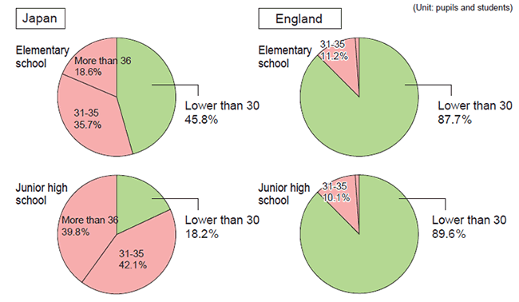
School Statistics
Class sizes are significantly larger than other
countries.
Notes:
he standard of the number of students in a class stipulated by the law is 40 students
for a regular class, eight for a class for special needs education and six for
elementary and junior high schools for special needs education (three for children with
multiple handicaps).
The average class size at national and public schools in Japan (2007) is 28.1
students for elementary schools and 33.0 for lower secondary education schools,
which are above the OECD average, giving Japan one of the highest national
figures.

Slide 6
The School Hierachy
Kocho Sensei
Fukukocho / Kyoto Sensei
Kyoumubucho
Bucho / Shunin
Jimubucho
Jimushokuin
Sensei
Tantosha
You
Notes:
Kocho Sensei1. School Principal- He oversees and watches the school'sprocedures and activities2. Always show respect3. Has their own office (and is probably the only school official who does)B. Fukukocho or Kyoto Sensei1. Vice-Principal- Vice Principal usually gives the schoolfaculty the permission to do things (Business trips, Club trips, etc)2. They are in charge of keeping the school in running order.3. Always show respectC. Kyoumubucho-This person is the head teacher under the Vice-PrincipalD. Bucho/ Shunin- This person is head teacher of their subject or divisionE. The Jimushitsu, Jimubucho and Jimushokuin1. The Jimushokuin is the school office2. The Jimubucho is the office boss3. The Jimushokuin may take care of your pay and other important things. Be verynice to them!F. Your Supervisor- Tantosha1. Any requests, problems, or questions go directly to your supervisor.2. If your supervisor isn’t around, the other English teachers are your defaultsupervisors.3. Take a matter to a higher up only if instructed to do so by yoursupervisor (If your supervisor is the problem, talk to your P.A.)

Slide 7
Meet Your Teachers
1,338,854 teachers in Japan.
  111,111 (11%) in KG
  417,553 (41%) in ES
  254,235 (25%) in JHS
  235,062 (23%) in HS
Overall ~50% female
  Heavyly scewed at
  different levels

Slide 8
Meet Your Teachers
Most teachers are prefectural employees.
Teachers are generally employed for life.
- Promotion is based on seniority.
- Dismissal is rare, and normally only for unethical conduct.
Teachers change schools every few years.
~90% have completed a 4 year degree course.
      - The majority in a field other than education.

Slide 9
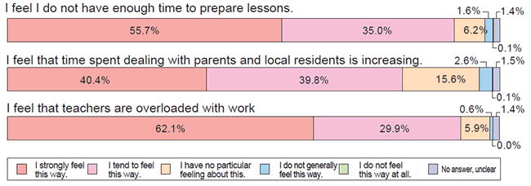
Teaching Conditions
Source:2006 Report on the Survey on the Actual Conditions for Teachers (Elementary and Junior High Schools), MEXT.

Slide 10

Meet Your Students
At least 210, typically 240 to 250 days a year.
  A full month more than American students!
30 hours of Lessons per week.
~60% attend cram schools.
Almost all are club members.
>96% continue to high school.
Notes:
Juku figure changes with age and prestige.
Club activities take a significant portion of the student's time.

Slide 12

English at School
English is compulsory from grade 5 (age 10) onwards.
From JHS English takes 140 class hours per year.
~400 new words a year
  + Various idioms and grammatical forms.
Based on the communicative approach.
Notes:
They may have previously studied English at elementary level; communicative approach – goal is to communicate, not translate.

Slide 13
An English Lesson
Typically 50 minutes long.
Mainly textbook based.
  Read ahead and plan activities around it.
Role of the ALT:
  Provide insight and useful expressions
  Interact with and motivate students
  Give them confidence
ALT should (ideally) speak only English.
ALT only present for a few of the lessons.
  Make them special.

Slide 14

Studying English
In class instruction includes:
Memorizing vocabulary
Practicing basic sentences and grammar
Simple translations
At it’s most basic:
Brief passages are read and translated.
Students practice writing short compositions.
Notes:
Why are they the hardest? Because Japanese schools normally don’t require students to do creative writing or speeches.

Slide 15
English and YOU
Where do you fit into all this?
ALTs always work together with a JTE (Japanese
Teacher of English) to plan and teach classes.
Your job is to assist JTEs by providing input, insight
and interesting activities.
Show your students natural English and let them
negotiate meaning.

Slide 16

Why is English Important?
World’s universal language.
  Set to become even more
ubiquitous in the future.
Selection criteria for high
school and university.
Make links with other
nations.
Requirement for many jobs.
  Lawyers, Doctors, Politicians
and Public Sector Workers.
Notes:
Takes up a significant chunk of time, so why is it compulsory? - Other reasons to come from Natsuko

Slide 19

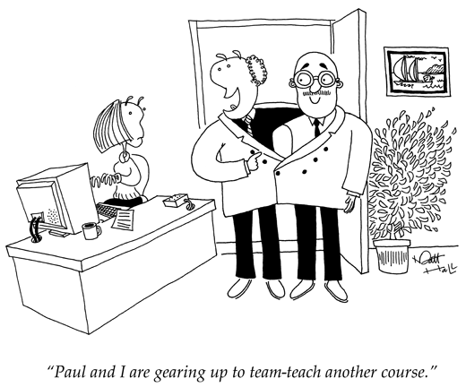
Team Teaching
Don’t just use your partner as a tape recorder /
translator.
  Good teaching practice is for
  both of you to work together.
Notes:
As we can see, ALTs and JTEs have clearly defined roles in the classroom.
These roles are part of an approach to learning called team teaching.

Slide 20
What is team teaching?
Team teaching involves a group of instructors working purposefully, regularly, and cooperatively.
Together they set goals, design a syllabus, prepare
lesson plans, teach, and evaluate results.
They share insights, experience, and perhaps even
argue to decide which approach is best.
Notes:
Through all my time on JET and sitting through multiple lecture on the subject, no-one ever mentioned exactly what team teaching is.

Slide 21

Benefits of Team Teaching
Research shows team teaching is best.
Methods and results can be evaluated.
  Future classes get better.
Newer teachers can be critiqued.
  Help other teachers in the future.
Teacher strengths are combined and
weaknesses remedied.
  Eliminates personality clashes.
More time for each student.

Slide 22

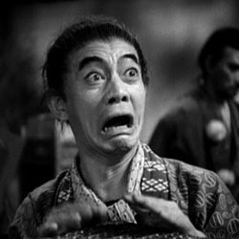
A Brief History of ALTs
In the mid 80’s countries were ranked by their scores on the TOEFL (Test Of English as a Foreign Language).
Of the 189 UN countries that took part, Japan ranked in at number:
180

Slide 23
J.E.T.-nesis (sorry!)
The JET program was born in 1987 as a response to this.
An attempt to bring western style language learning to
Japan (communicative approach).
ALTs offer:
  Native language experts
  A chance to practice non-textbook English
  Motivation and rewards for good students

Slide 24
The JET Effect
TOEFL scores have improved
  Japan has surpassed about 50 countries, bringing them close to the international average.
Everyone in Japan under 40 has had a positive experience with foreigners and second languages.
More and more Japanese students are studying at foreign universities, despite rising costs.
Government poll found “high degrees of satisfaction from…schools taking part” in the JET Programme.
Now, it’s your turn!

Slide 25
Why We Are Here
We are here to:
  Assist with teaching to the best of our abilities.
  Introduce students to our native languages and cultures.
  Acclimate students to interacting with foreigners.
  Illustrate, however abstractly, that second languages are real and maybe even useful.
  Be an ambassador for your country.
Notes:
Most ALTs aren’t trained teachers, and we aren’t expected to be

