Slide 1
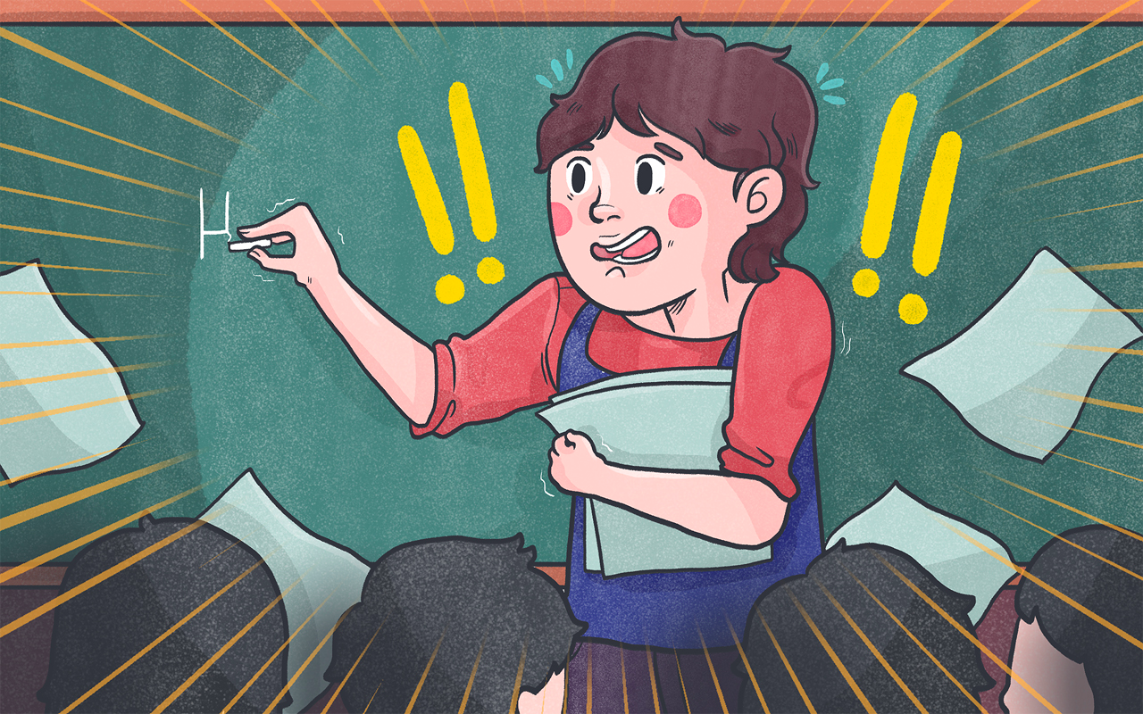

Slide 2
Dont Panic!
You are not T1
You have time to settle in - self intros, sports festival, enkai, etc.
Sort your self intro - find out what tech, how long etc

Slide 3
Let’s Start Simple - JHS
☺

Slide 4
Junior High School
English is required at all levels
There will be several classes throughout the week and you probably won’t go to all of them.
Depending on the JTE, you will be everything from a human tape recorder to the master of lessons (rare).
Notes:
http://akitajet.com/wiki/JHS_activities
Each class at JHS will have around 3 English classes a week. Depending on the size of your school(s), you may find that you go to all the classes each week for each grade, or you may only see each class once per week. In the latter case, the JTE might do the (boring) text book/grammar work when you’re not around and save the listening/speaking/worksheets/games for the lessons you attend. In this sense, you may find yourself as the provider of light relief from the more serious study required to prepare students for their exams.
The more classes you go to, the more likelihood that you will find yourself as the human tape recorder for at least some of the time. Remember that although this may seem boring to you, part of learning English is pronunciation and as ALTs we are the best models of it, so this is a requisite part of their language education.
Whatever your role in the classroom, be sure you establish a good relationship with your JTEs as early as possible. Try to get together with your JTE a week (or at least a day) before a lesson and see if there is anything they want you to prepare. Something reasonable to expect would be them asking you to make a worksheet for a certain page of the textbook or practicing a set grammar point; designing an interview or other speaking activity that lasts for 15-20mins; making some flashcards; preparing an oral introduction on a particular subject; etc.
The better your relationship with your JTEs, the more receptive they will likely be to your ideas. If you are looking to get more involved in your classes, think about designing/making activities proactively and then showing them to your JTEs. In most cases they will be more than happy to use your ideas, but more often than not may forget to approach you in advance about preparing something simply because they are very busy people. When you first arrive and throughout your time in Japan, you will have opportunities to learn and share many ideas with current ALTs within Saga Prefecture. There are also many great online sources to help you, so if you are not sure what a worksheet should look like, or how to make a good activity, just ask one of us! There is also an online database created by past and present Saga JETs which you can access through the Saga JET website, which has numerous resources arranged by grammar point.
http://www.tofugu.com/2014/06/30/special-education-on-japanese-special-education/

Slide 5
Brief Outline of a Day
Schedule
Meet with your JTE (maybe)
Keep an eye out for:
  Meetings, short schedules, assemblies…
Notes:
http://akitajet.com/wiki/A_day_in_a_Japanese_junior_high_school

Slide 6
Let’s enjoy lesson planning
Most JHS ALTs won’t plan a full lesson
Usually JTEs will ask you to prepare a lesson or a worksheet (this may take up the whole class period)
If a JTE doesn’t ask you to do anything, make something anyway and leave it on their desk

Slide 7
Communicating with JTEs/HRTs
Your relationship with your JTE defines their expectations of you.
A JTE that trusts you will give you more room to plan activities/lessons
Sometimes JTEs will just forgot to ask you plan anything. Being proactive helps prevent this.
Notes:
http://akitajet.com/wiki/Communication_problems
http://akitajet.com/wiki/Meeting_with_your_JTEs

Slide 8
When things go bad...
Don’t worry. One lesson that works with one class/school can crash with another…
Know each classes’ level and plan accordingly
Talk with your JTE about what went wrong and how you can fix it.

Slide 9
Outside the Classroom
Speech Contests
English Boards
Club Activities
Class Observations
English Clubs
Field Trips
Notes:
http://akitajet.com/wiki/In-school_projects

Slide 10
Elementary School
You will be teaching 5th and 6th grade
  However, you may be asked to teach the younger grades from time to time.
Your co-teacher is a regular elementary school teacher and will speak little to no English along with every other teacher at that school.
Notes:
In theory, the HRTs are meant to lead English classes with ALTs acting as assistants, but in reality you may find that depending on the school, you may be expected to plan and lead all classes. If you feel you shouldn’t be the main teacher, and it is becoming a problem, then speak with your BoE as it is not technically your responsibility (unless of course you find you prefer it!)
At ES, lessons mostly consist of speaking and listening exercises to build vocabulary and also simple sentences. For grades 5 and 6, there are English textbooks called ‘Hi, Friends’. You can read a review of the book here. These textbooks were introduced to schools at the start of the last fiscal year. They are very similar to the books used before this year called ‘Eigo Noto’ so if your predecessor or schools give you Eigo Noto-based activities, they are very easy to tweak to suit ‘Hi, Friends’.
Having this textbook is very useful if you are nervous about teaching on your own. Depending on your schools (or even yourself if you are in charge of the classes), you can either strictly follow the books or use them as a loose structure to plan your own activities around.
http://akitajet.com/wiki/Common_problems_for_ALTs_(Elementary)

Slide 11
Elementary School
Text books: Hi, Friends
These books are very short!
Expand on these short chapters
Have many games
Prepare culture, holiday and other fun lessons in-between chapters

Slide 12
Sample Classroom Time Outline
First period: 8:40am – 9:25am
Greetings – 5 mins
Short review or song review - 5 mins
Main Lesson – 15-20 mins
  Introduction of lesson
  Speaking practice
  Activity, group practice, writing (advanced students).
Games, questions, review - 5-10 mins
Student reflection/class surveys – 5 mins

Slide 13
Questions to Ask
When do I have to arrive at school?
What should I prepare?
What is today’s schedule?
Are there any changes to the schedule?
Are there any exams? Events? School trips?
When should I leave?
Can I get the yearly schedule?

Slide 14
Stickers GET!
Everybody, from 1st year elementary to 3rd year middle school, loves stickers.
When you go home for vacation, come back with loads of stickers.

Slide 15
Game Ideas
Jeopardy
PowerPoint games
.gifs
Bingo
Battleship
Pass the ball
Ninja Gaiden
Fly Swatters
Fruits Basket
Castles
Dice off

Slide 16
Know that Face
PASSPORTS
Name Cards

Slide 17
Common Problems
Notes:
http://akitajet.com/wiki/Communication_problems
JTE is too busy
JTE tells you to prepare something 5 minutes before the lesson starts
JTE gives you nothing to do
JTE gives you too much to do (complete lesson planning)
Inappropriate touching (kancho)

Slide 18
Questions

